Slide 1



PHISHING WEBSITE DETECTION PROJECT
Presented by:
David Chege
Royce Bett
Gladwell Chepkorir
Winny Chepkoech

Slide 2









MEET THE TEAM
"Introducing the Dream Team: Empowering Data-Driven Solutions to Combat Phishing Websites!"
David Chege
Royce Bett
Gladwell Chepkorir
Winny Chepkoech
Team Lead
Member
Member
Business Head

Slide 3




OVERVIEW
1
2
3
3
4
5
introduction
Business context
data understanding
data overiew
data process steps
data preparation
6
7
8
9
10
11
EDA
MODEL PERFOMANCE
EVALUATION
Ddeployment and conclusion
recommendation
next steps

Slide 4


INTRODUCTION
In today's digital landscape, phishing websites pose a significant threat, with attackers creating fake sites to deceive users and steal sensitive information.
This project focuses on developing a machine learning solution to accurately classify websites as either phishing or legitimate.
By harnessing data-driven insights, we aim to provide an automated, efficient tool that enhances cybersecurity efforts and protects users from potential fraud.

Slide 5





OBJECTIVE
To develop a machine learning model to classify URLs as either legitimate or malicious based on structural, content, and behavioral characteristics. The model aims to achieve high accuracy, precision, and recall in identifying potentially harmful URLs.

Slide 6


DATA UNDERSTANDING
The dataset for this project includes:
URL-related features labeled as legitimate or malicious.
Key attributes cover URL structure (length, domain, subdomains, TLD), content (title, favicon, social network links), behavior (redirects, pop-ups, external form submissions).
The target variable indicates whether a URL is legitimate (1) or phishing (0), supporting accurate classification based on these structural and behavioral indicators.

Slide 7






Data Process Steps
Data Preparation
EDA
Modelling
Deployment
Results

Slide 8

Data Preparation
The data cleaning process involved checking for duplicates and missing values, with no duplicates or missing values found. This ensures the dataset is complete and ready for further analysis and model development.

Slide 9

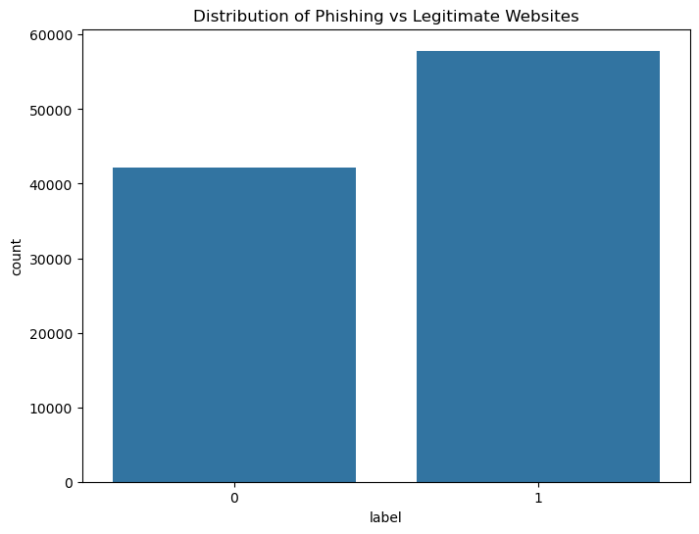

EXPLANATORY DATA ANALYSIS
Class Distribution Analysis:
Data shows a balanced distribution between phishing and legitimate websites, aiding in model training accuracy.
Nearly equal representation improves the model's ability to distinguish between phishing (label 0) and legitimate (label 1) websites effectively.

Slide 10


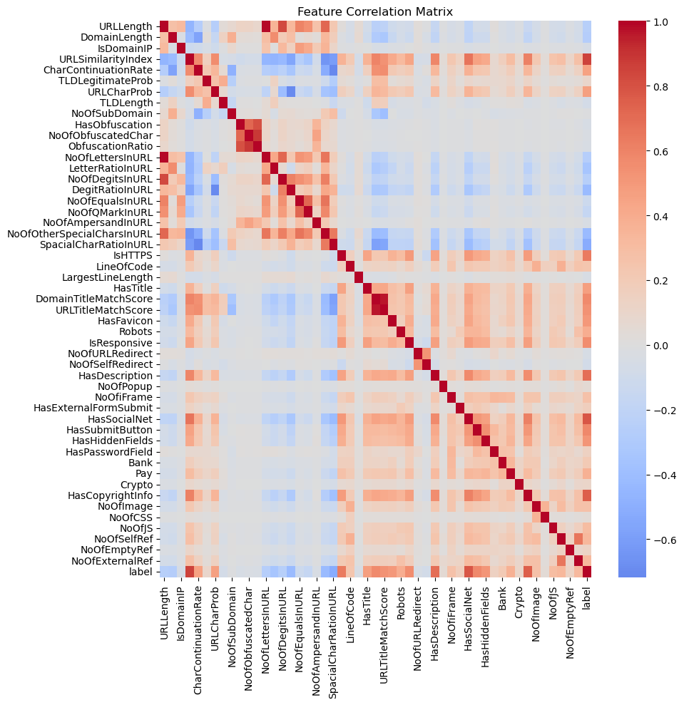
FEATURE CORRELATION ANALYSIS
High correlation observed among URL-based features, indicating redundancy.
Weak correlation between most features and the label, suggesting non-linear relationships.
Feature selection can be optimized to reduce multicollinearity and improve model performance.

Slide 11
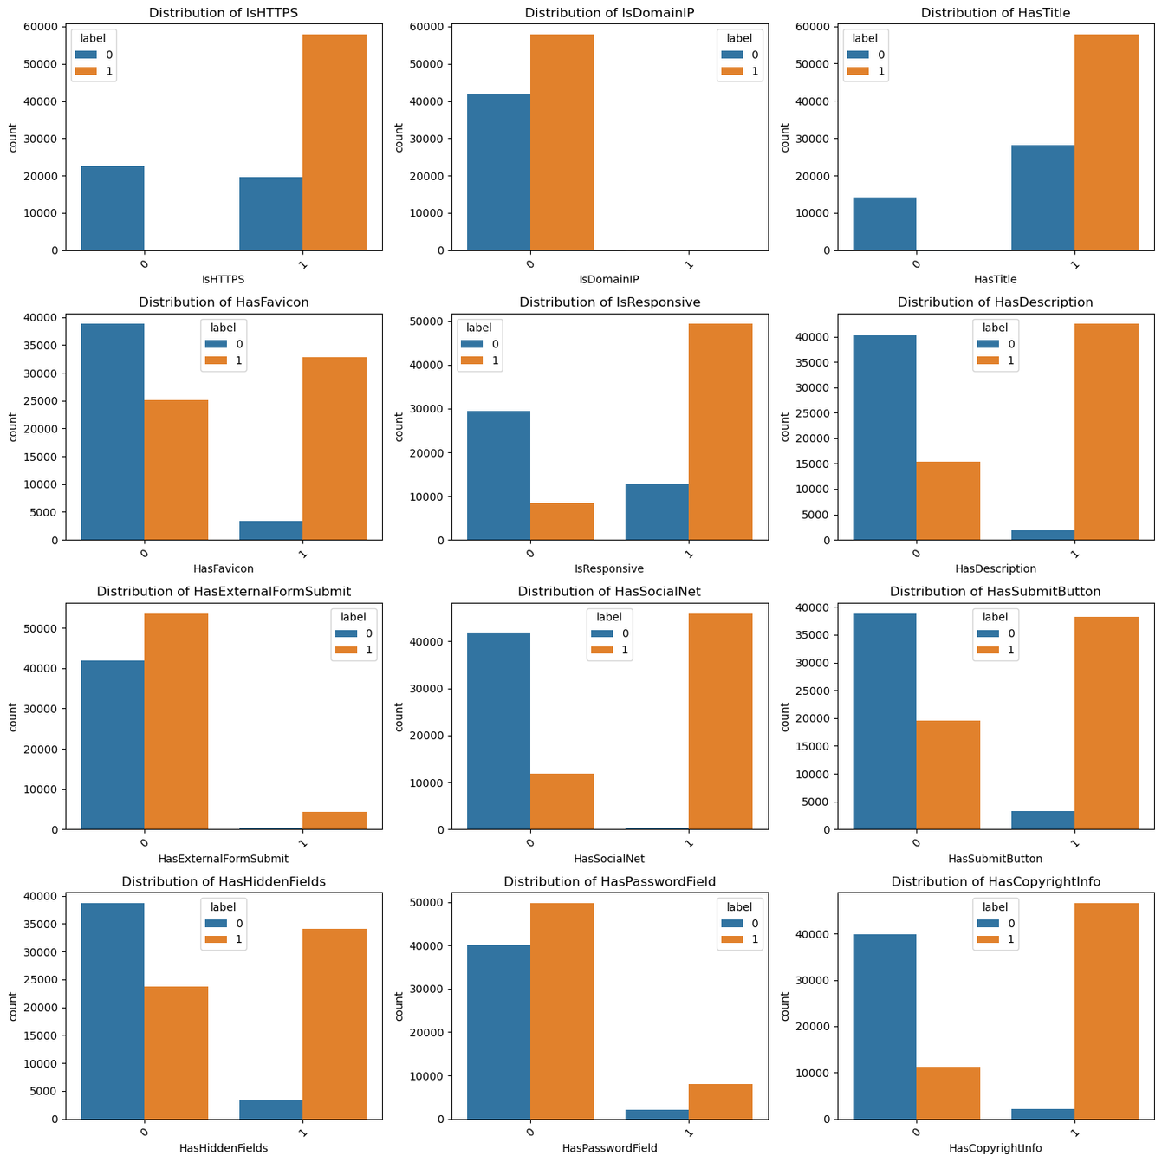

Feature Distribution Across Phishing and Legitimate Websites
HTTPS and IP usage are strong indicators, with phishing sites often lacking HTTPS and using IPs.
Social media and form elements differ between phishing and legitimate sites, impacting detection.
Presence of hidden fields and lack of copyright info are common in phishing sites.

Slide 12
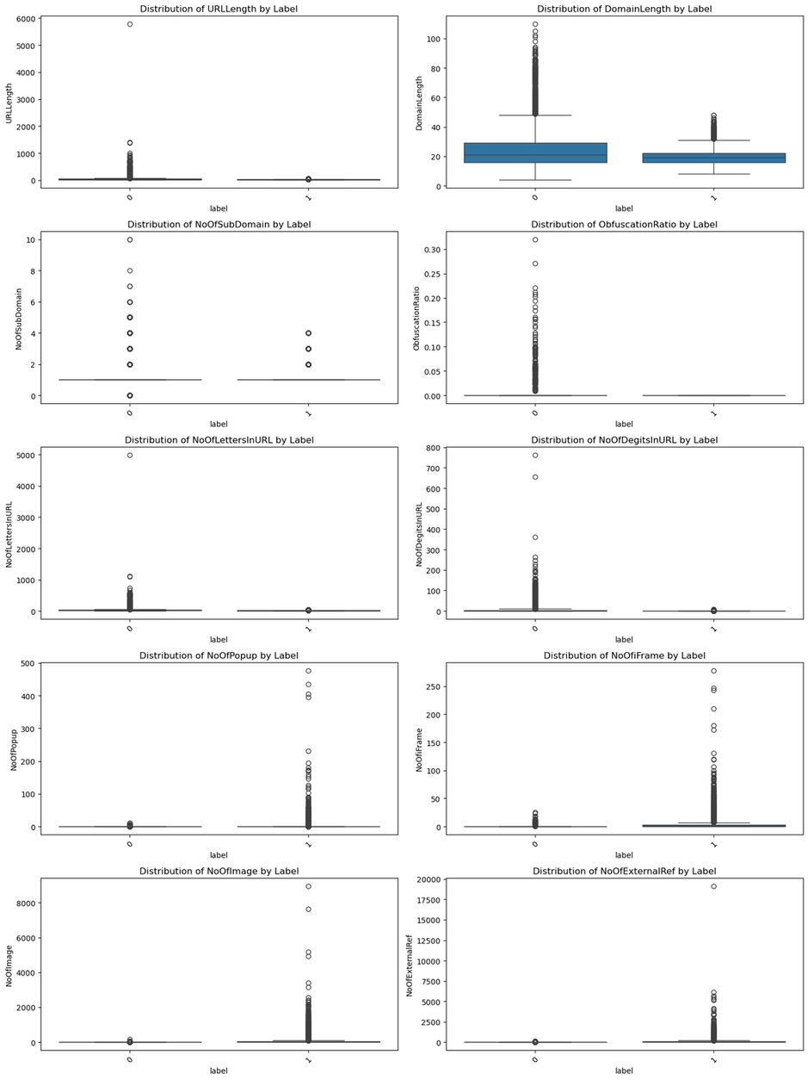
Outlier Analysis
URL Length and Domain Length have outliers, especially in phishing sites, indicating variability in phishing URL structures.
Number of Popups and Iframes is generally higher in phishing sites, suggesting more intrusive elements.
External References are significantly higher in phishing sites, likely to mislead users.

Slide 13
Feature Engineering
Outlier removal eliminated 70.79% of rows, reducing the dataset to 29,210 rows, with significant adjustments to features like NoOfSubDomain, NoOfDegitsInURL, and LineOfCode due to extreme values from unusual or malicious URLs.
Multicollinearity through a correlation matrix with a threshold of 0.9 led to the removal of 6 features, leaving 49 features in the dataset for more reliable analysis and modeling.

Slide 14
Dealing with Overfitting
Principal Component Analysis (PCA) and TF-IDF Vectorizer were used to reduce dimensionality and add noise to the dataset, while SMOTE (Synthetic Minority Over-sampling Technique) was applied to address class imbalance by generating synthetic samples for the minority class. These techniques helped improve model performance and mitigate issues related to overfitting and imbalance.

Slide 15
Models & Performance Metrics
Trained Models and Performance Metrics | Trained Models and Performance Metrics | Trained Models and Performance Metrics | Trained Models and Performance Metrics
Model | Accuracy | Precision | Recall
Logistic Regression | 96% | 97% | 97%
Decision Tree | 99% | 99% | 99%
Random Forest | 99% | 99% | 99%
LightGBM | 99% | - | -
XGBoost | 99% | 99% | 99%
Deep Neural Network | 97% | 97% | 97%
. | Model Selection Selected Model: Logistic Regression Reason for Selection: Chosen for deployment due to its interpretability, high accuracy, and computational efficiency. | Model Selection Selected Model: Logistic Regression Reason for Selection: Chosen for deployment due to its interpretability, high accuracy, and computational efficiency. | Model Selection Selected Model: Logistic Regression Reason for Selection: Chosen for deployment due to its interpretability, high accuracy, and computational efficiency.

Slide 16
Evaluation
Evaluation Metrics:
•- Accuracy: High accuracy across models.
•- Precision: Focus on minimizing false positives.
•- Recall: High recall to ensure phishing URLs are not missed.
•- F1 Score: Balanced performance for phishing detection.
Result
Logistic Regression provides a balance between performance and interpretability. It is considered a more practical choice for deployment due to its simplicity, efficiency and ease of implementation.

Slide 17
Deployment
Streamlit was used to create the interactive app, providing a user-friendly interface for model deployment and visualization. The app was hosted on Streamlit's cloud servers, ensuring accessibility and scalability for users to interact with the model in real-time.

Slide 18
Conclusion
The project aimed to classify websites as phishing or legitimate, evaluating various models for predictive performance.
Both Deep Neural Networks (DNNs) and Logistic Regression achieved high precision, recall, and F1-scores around 0.97, but showed signs of overfitting, suggesting they might struggle to generalize to new data.
While the DNN offered robust performance, it required more computational resources and longer training times.
In contrast, Logistic Regression, though simpler, matched the DNN’s performance with faster training, easier deployment, and fewer resources. Given its simplicity and efficiency, Logistic Regression emerged as the optimal choice for a production-ready phishing detection system.

Slide 19
Recommendations
Data Collection: Expand and update the dataset regularly to cover a wider range of legitimate and phishing websites, enhancing model adaptability to new tactics.
Feature Engineering: Extract more nuanced features (e.g., URL structure, domain age, SSL details) to improve detection and insight into phishing patterns.
Deployment & Monitoring: Establish a real-time monitoring and retraining pipeline to adapt the model based on feedback and maintain detection accuracy.
Security Compliance: Ensure the system adheres to privacy regulations and secure practices, with regular audits to maintain trust.
Scalability: Design for scalability and integrate with existing security tools (e.g., browser extensions) to enhance usability and impact.

Slide 20
Next Steps
To enhance the phishing detection system, future projects should focus on :
Expanding the dataset, improving feature engineering, and implementing real-time deployment and monitoring for continuous improvement.
Incorporating user education, ensuring security and compliance, designing for scalability
Collaborating with cybersecurity experts will strengthen the overall effectiveness and adaptability of the system.

Slide 21


